Slide 1


Slide 2
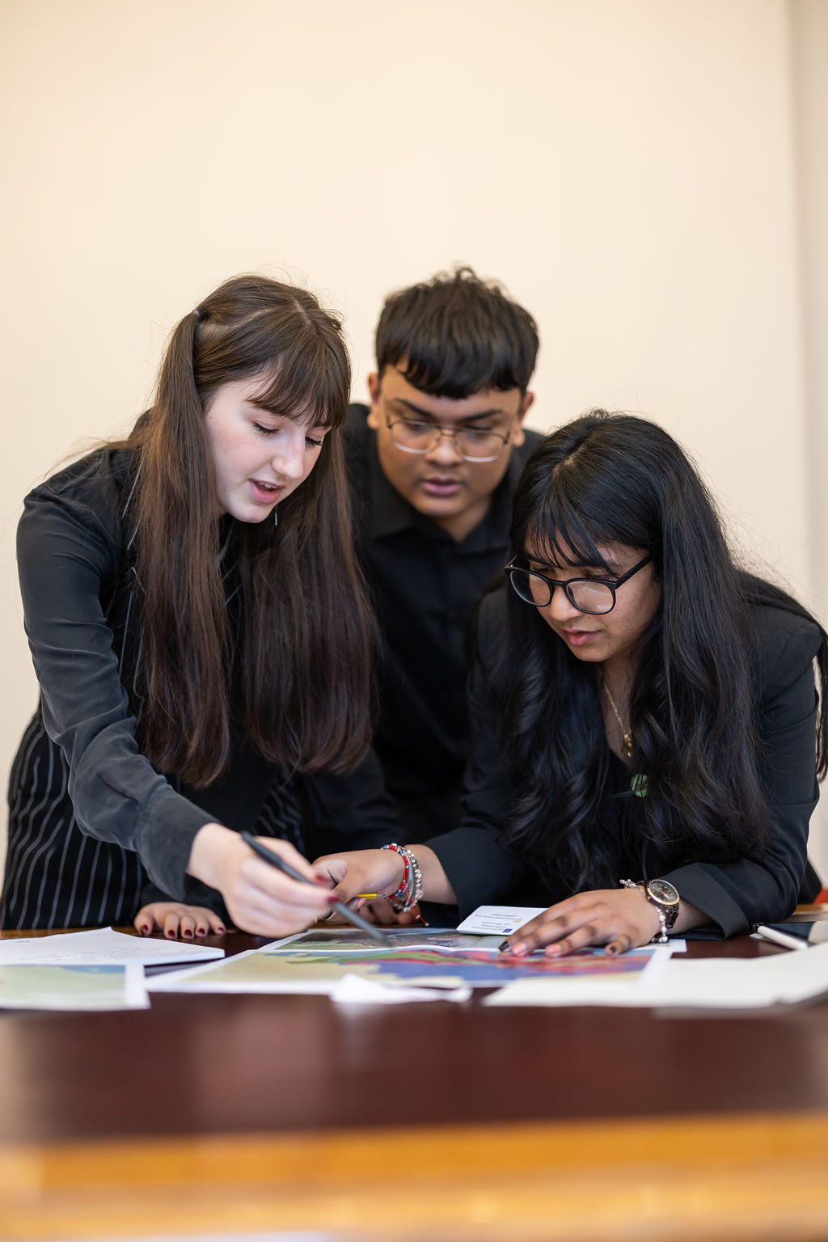
What is Schools Geology Challenge?
The Schools Geology Challenge is an annual competition run by the Geological Society.
The competition is aimed at students aged 16-18 and you don’t have to study geology to enter!
The competition is open to any interested students who are currently studying geology, geography or science A-levels, Advanced Highers or equivalent.

Slide 3

What is Schools Geology Challenge?
The competition is split into two parts: the Qualifiers and the Final.
Qualifiers:
Teams enter a piece of media on a geoscience topic of their choice for an online audience. The top 10 teams are chosen for the final.
Final:
Teams compete in a problem-solving activity at The Geological Society HQ to win!

Slide 4
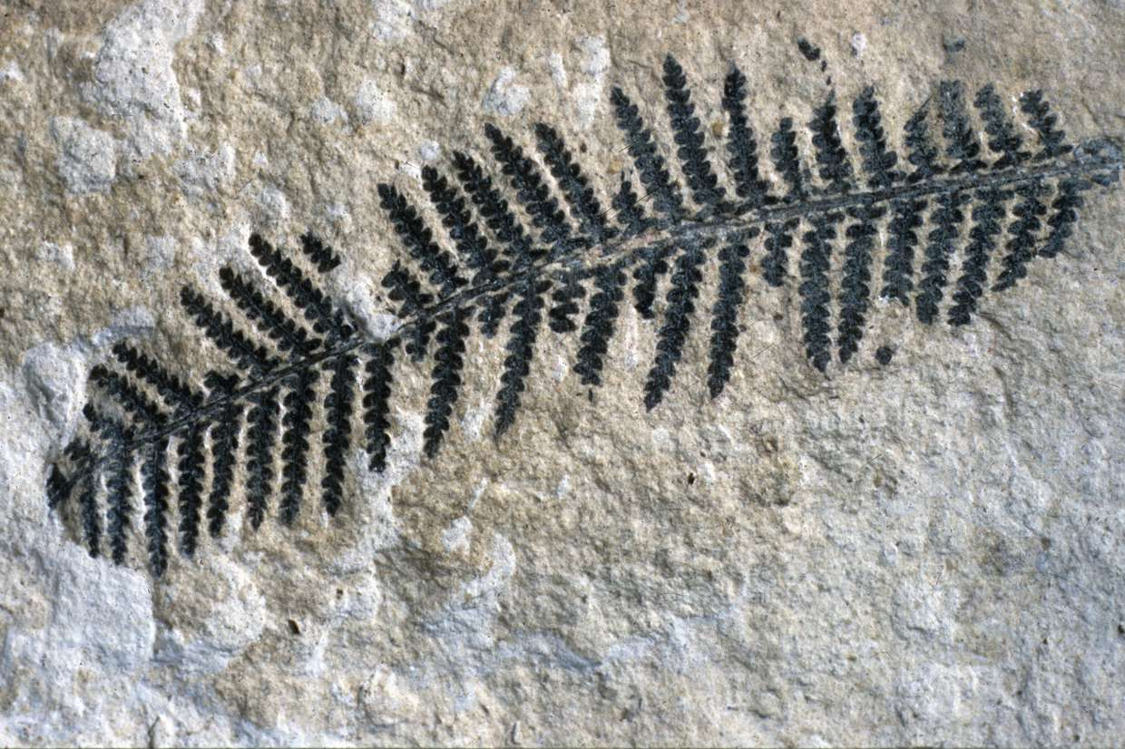
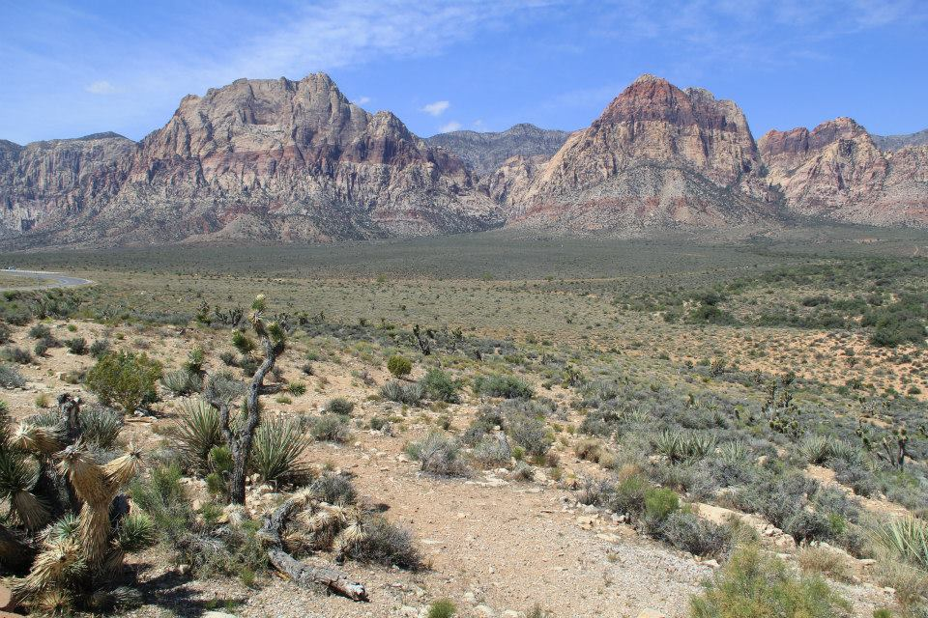
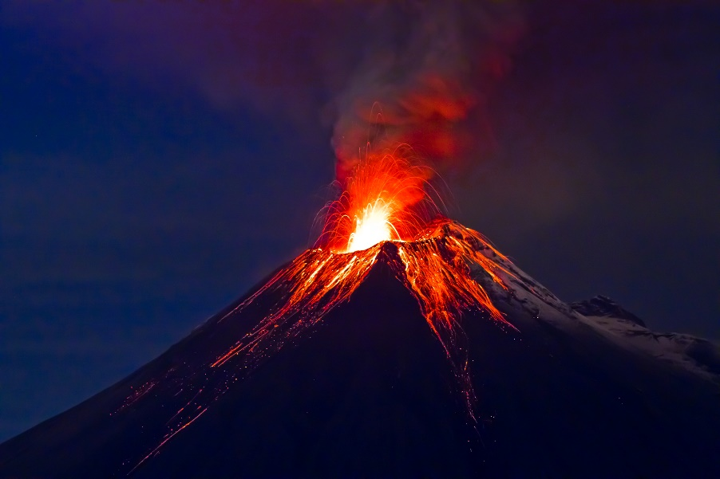
What is Geology?
Geology, also known as ‘geoscience’ or ‘earth science’, is the study of the structure, evolution and dynamics of the Earth and its natural resources.
Geology investigates the processes that have shaped the Earth through its history and uses rocks, minerals and fossils to unravel that history. It is concerned with the real world and has direct relevance to the needs of society.
Geology tells us about the composition and structure of all planets - even those in outer space!

Slide 5

Your Task
Could you make an entry for the Qualifiers?
In teams of up to six, create and present a geoscience topic to an online audience:
  Your topic can be anything you like! It could be tied in with your school curriculum or inspired by your own experience; it could be a case study, a concept, or phenomenon.
  Be creative in how you present your topic – maybe as an interactive website, a mini documentary or a cartoon strip.
  Make sure to include all references!

Slide 6
Past Topics
The Geology of Pluto
Space Volcanoes
Wales: From The Cambrian to the Quaternary
Mount Everest
Yellowstone National Park
Geology of My City

Slide 7
Need Inspiration?

Slide 8
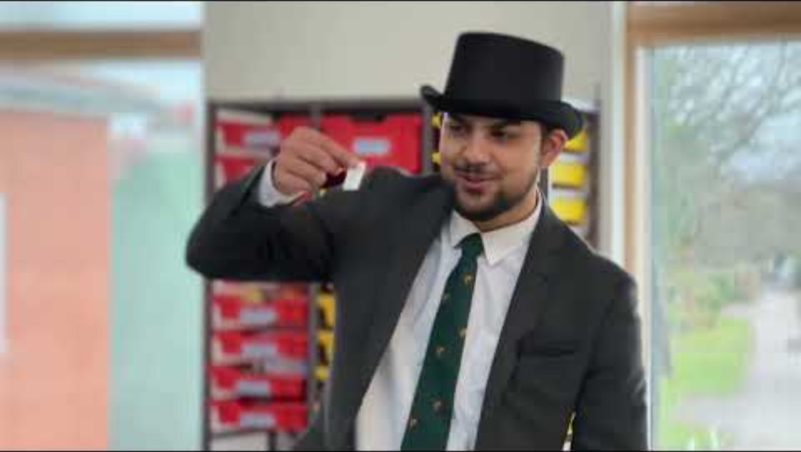

Slide 9

Past Entires for inspo
https://sites.google.com/view/thegeologyofarchitecture/home
https://sites.google.com/view/thegeologyofarchitecture/home

Slide 10


Slide 11
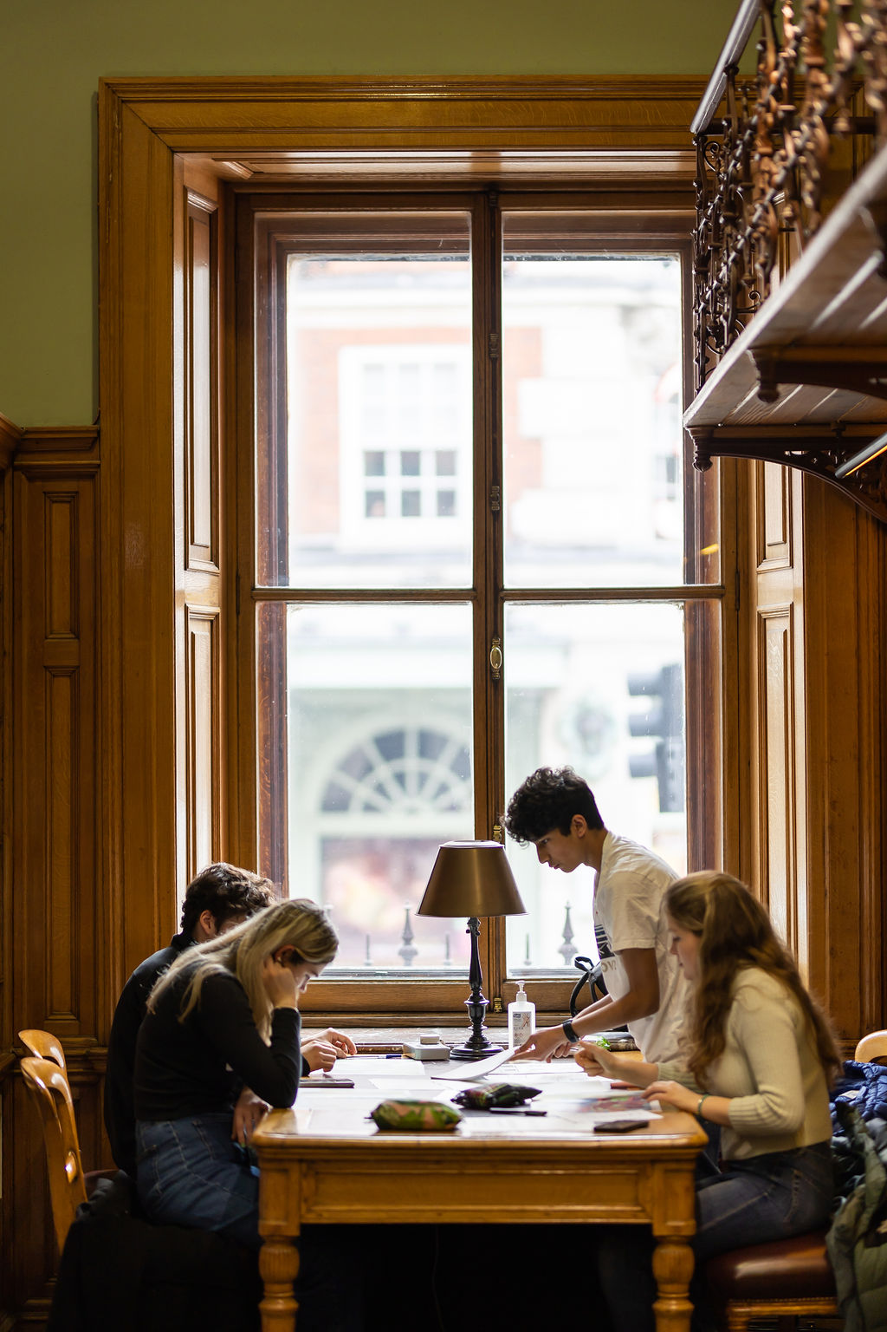
Top Tips
Make sure the information you are presenting is clear and concise
Use visuals to enhance understanding
Ensure your content is accurate and sourced, make sure to include references
Keep it interactive and engaging!

Slide 12
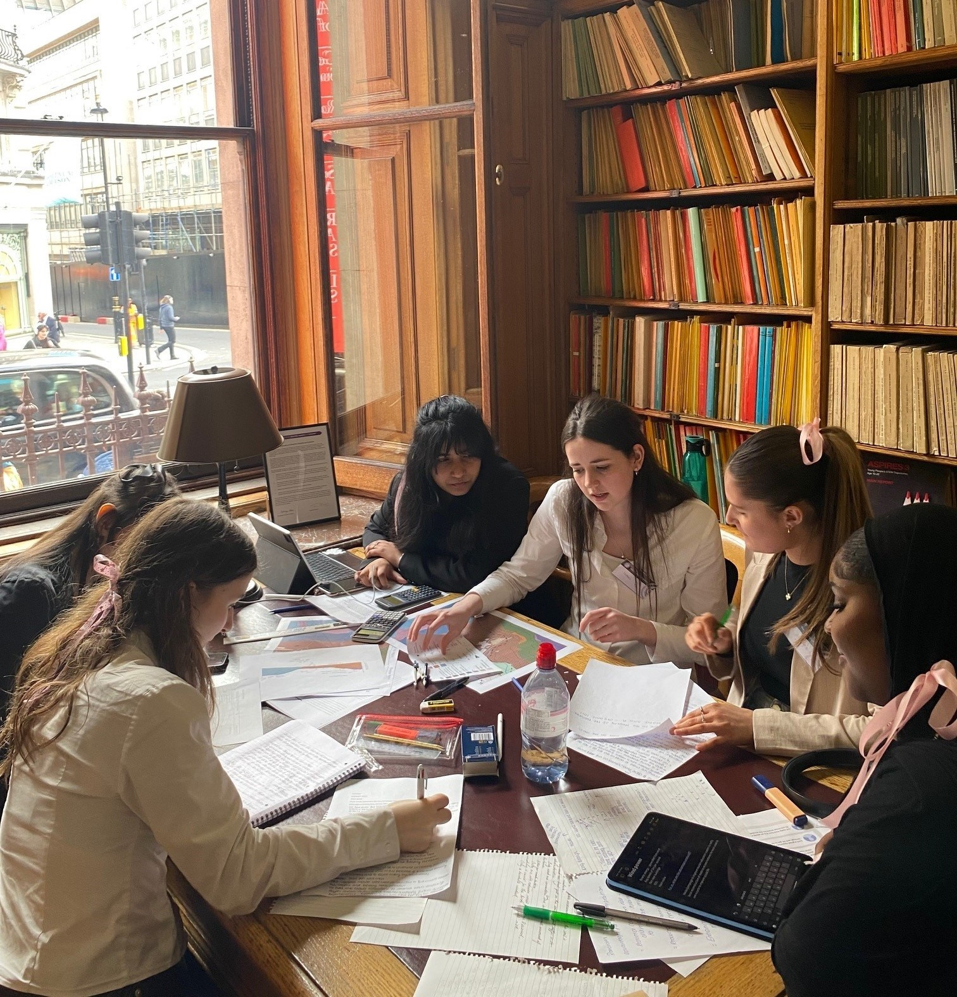
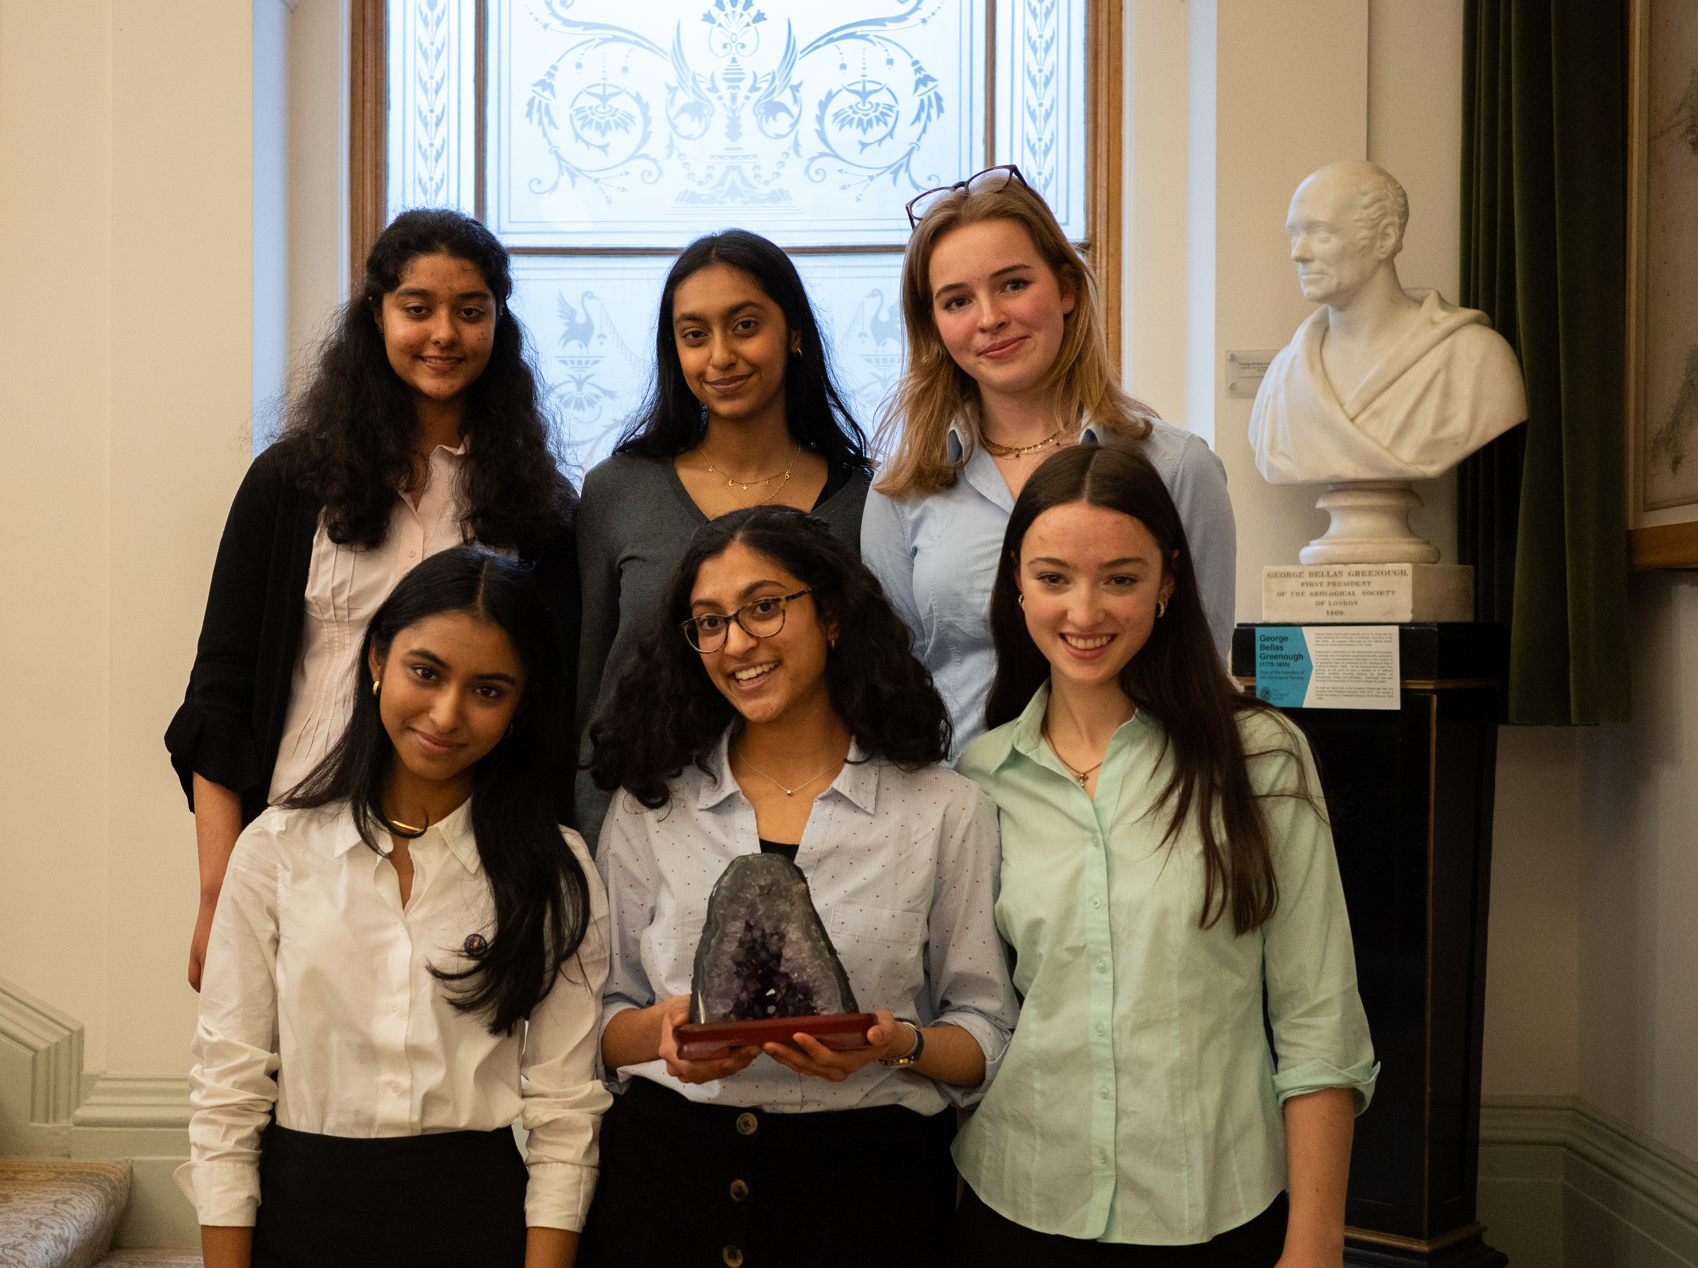
Good Luck!
Once you have created your project, why not submit it to the Schools Geology Challenge? Entries for the qualifiers closes on 31 January 2025.
The top 10 teams get to come to our HQ in Piccadilly, London to take part in the final!
First prize includes the coveted Schools Geology Challenge Trophy, £500 to use towards geoscience education at your school and a year’s Student Membership to the Geological Society!
For more information and to submit your entry visit: www.geolsoc.org.uk/geochallenge

Slide 13
Submit Your Entry Here

